Slide 2
association
<UML> semantic relationship (3.63) that can occur between instances (3.42) that have a type (3.70)
Note 1 to entry: An association is also a kind of classifier (3.16).
classifier
<UML> classification of instances (3.42) according to their features (3.36)
Note 1 to entry: A classifier is a kind of type (3.70).
A property can be either an attribute of a classifier or a member end of an association (UML 2.5.1, 9.5.3). The latter is also called an “association end”.

Slide 3
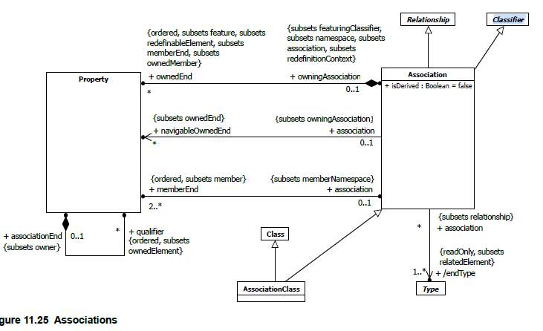

Slide 4
Uit iso 19103 – profile on uml
Meaningful association names as well as reading directions (⯈) aid a user in understanding the semantics of how the classifiers are connected, and hence reduce ambiguity.
Each association name should contain a verb phrase.
The role name of each association end should reflect the role that the classifier at the association end plays with respect to the classifier at the other end. The role name should not express the whole association. Consequently, a proper role name is a noun or a noun phrase.
If a binary association’s end has an open arrowhead (→), that association end is navigable. Navigability indicates that an object knows the object(s) it is connected to.
An association end owned by the classifier at the opposite end can also be represented using the attribute notation, instead of the association notation, according to UML 2.5.1, 11.5.4. The following conventions are common practice, see UML 2.5.1, 9.5.3, paragraph 2. They are also used in the diagrams in this document.
— A property whose type has identity is modelled using an association.
— A property whose type does not have identity is not modelled using an association.
N-ary associations should be avoided in the conceptual schema in order to reduce complexity and avoid model mapping problems.

Slide 5
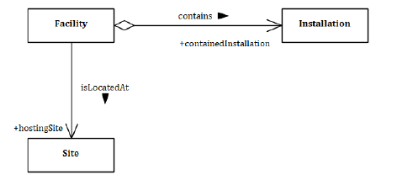

Slide 6
navigeren
If a binary association’s end has an open arrowhead (→), that association end is navigable. Navigability indicates that an object knows the object(s) it is connected to.
NOTE 1 UML 2.5.1, 11.5.4, defines the notation for a cross (×) for non-navigable association ends. However, using this notation is optional. It currently remains common practice to show the open arrowheads for navigable association ends and to suppress the crosses for non-navigable association ends.
NOTE 2 It has been common practice to assume that a navigable association end is owned by the classifier at the opposite end. This practice remains current, even though UML 2.5.1, 11.5.4, deprecates it.

Slide 7
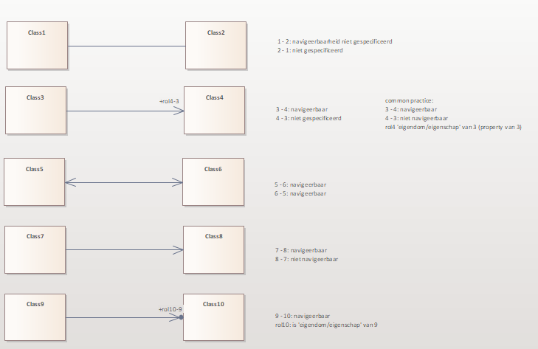
Mogelijke associaties

Slide 8
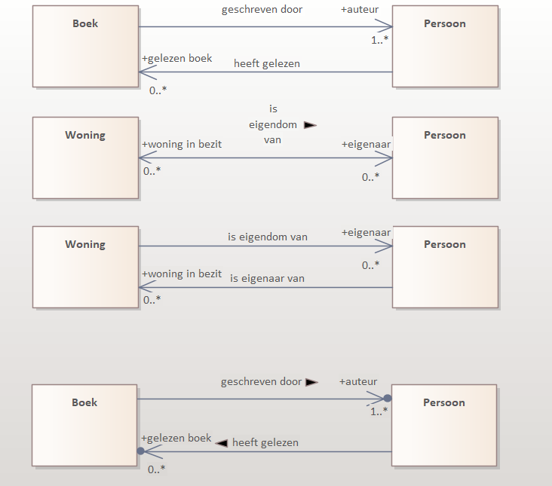
Common practice
Niet inverse
Wel inverse
Niet of Wel inverse?
Meest netjes

